Slide 2
Version Control and Revision History
 | Name | Date
Prepared By | Manisha Mane | 27-Jul-2018
Reviewed By | Nisha Mendonsa | 27-Jul-2018
Approved By | Gauresh Gaitonde | 27-Jul-2018
Version No. | Date | Section Affected | Highlight of Changes
1.0.0 | 23-Mar-2017 | All | Original Version.
2.0.0 | 27-Jul-2018 | None | Annual Review 2018. No changes made.

Slide 3










Iconic Representations.......
Coffee Break
Can you Solve?
FAQ
Test your Memory
Objective
Queries
Demo
Recap
Need more Info
Brainstorm

Slide 4
Objectives
SQL
Database Objects:
Sequences
Synonyms
Views
Indexes

Slide 5
Oracle SQL
Set Operations in SQL

Slide 6
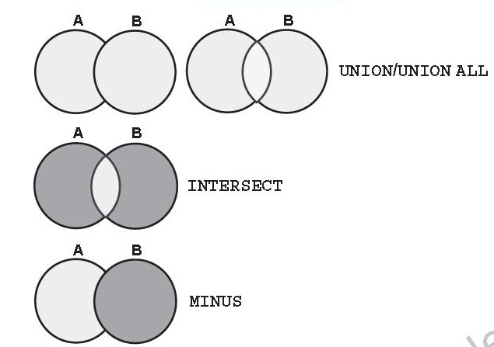
Set Operations:
Oracle provides SET operators to combine the result of more than one SELECT statements into one result set in a logical manner.
Set Operators are:
UNION ALL and UNION
INTERSECT
MINUS

Slide 7
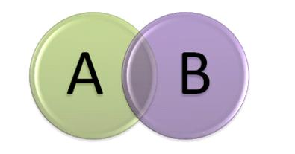
Set Operators:
UNION ALL:
operator simply unites the result sets of two SELECT queries, without eliminating duplicates from the combined result set.
In addition, it doesn’t sorts the final result set in any order.
UNION :
operator simply unites the result sets of two SELECT queries, eliminating duplicates from the combined result set.

Slide 8
Set Operators:
UNION ALL
Example
Ordering of the UNION ALL query result set can be achieved using positional ordering mechanism.
SELECT JOB_ID
FROM EMPLOYEEs
WHERE DEPARTMENT_ID = 10
UNION ALL
SELECT JOB_ID
FROM EMPLOYEEs
WHERE DEPARTMENT_ID = 20

Slide 9
Set Operators:
UNION ALL
Order BY Clause in Set Operation
Example :
If you omit the ORDER BY, then by default the output will be sorted in the ascending order of employee_id. You cannot use the columns from the second query to sort the output.
SELECT employee_id, job_id,salary FROM employees UNION SELECT employee_id, job_id,0 FROM job_history ORDER BY 2;

Slide 10
Set Operators:
MINUS:
Operator return all distinct rows selected by the first query, but not present in the second query result set (the first SELECT statement MINUS the second SELECT statement).
Example: Display the employee IDs of those employees who have not changed their jobs even once.
SELECT employee_id
FROM employees MINUS SELECT employee_id
FROM job_history;

Slide 11
Set Operators:
INTERSECT:
Operator simply returns all rows that are common to multiple queries.
Example: Display the employee IDs and job IDs of those employees who currently have a job title that is the same as their previous one
SELECT employee_id, job_id, department_id FROM employees INTERSECT SELECT employee_id, job_id, department_id FROM job_history;

Slide 12


Set Operations:
Some Guidelines while using sub queries are:
The expressions in the SELECT lists must match in number.
The data type of each column in the second query must match the data type of its corresponding column in the first query.
ORDER BY clause can appear only at the very end of the statement.

Slide 13
Oracle SQL
Joins in SQL

Slide 14
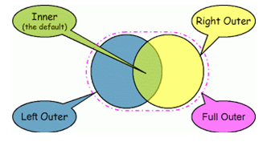
Joins:
Joins help retrieving data from two or more database tables.
The tables are mutually related using primary and foreign keys.
A programmer writes a JOIN predicate to identify the records for joining.
If the evaluated predicate is true, the combined record is then produced in the expected format, a record set or a temporary table.
Types of Joins:
Inner Join
Self Join
Outer Join

Slide 15
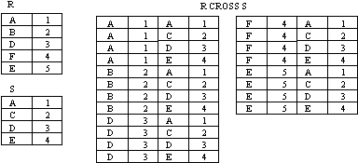
Why use Joins?
A Cartesian product is formed when:
A join condition is omitted
A join condition is invalid
All rows in the first table are joined to all rows in the second table
To avoid a Cartesian product, always include a valid join condition in a WHERE clause.

Slide 16
Joins:
To join the tables:
Write the join condition in the WHERE clause.
Prefix the column name with the table name when the same column name appears in more than one table.
Improve performance by using table prefixes.
Optionally distinguish columns that have identical names but reside in different tables by using column aliases.
Note : To join n tables together, you need a minimum of n-1 join conditions.
For example, to join three tables, a minimum of two joins is required.

Slide 17

Joins
Inner Join:
A join in which the joining condition is based on equality between values in the common columns
Simplest type of join
Also called: Equality join, Equijoin, Natural join

Slide 18
Joins:
Inner Join
Example
When you perform an INNER JOIN, only rows that match up are returned. Any time a row from either table doesn’t have corresponding values from the other table, it is disregarded.
The keyword INNER is optional because a JOIN clause will be INNER by default.
An equijoin is a join with a join condition containing an equality operator ( = ).
SELECT e.employee_id, e.last_name, e.department_id, d.location_id
FROM employees e, departments d
WHERE e.department_id=d.department_id

Slide 19
Joins:
Non Equi-Joins
Non equi joins is used to return result from two or more tables where exact join is not possible
Example
SELECT e.last_name, e.salary, j.grade_level
FROM employees e, job_grades j
WHERE e.salary BETWEEN
j.lowest_sal AND j.highest_sal;

Slide 20

Joins
Outer Join:
Returns
all rows from one table (called inner table) and
only matching rows from second table (outer table)
Three types:
Left
Right
Full
The outer join operator is the plus sign (+).
LEFT OUTER JOIN keeps the stray rows from the “left” table (the one listed first in your query statement). In the result set, columns from the other table that have no corresponding data are filled with NULL values.
Similarly, the RIGHT OUTER JOIN keeps stray rows from the right table, filling columns from the left table with NULL values.
The FULL OUTER JOIN keeps all stray rows as part of the result set.

Slide 21

Joins:
Outer-Join
Example : LEFT Outer Join
SELECT e.last_name, e.department_id,d.department_name
FROM employees e, departments d
WHERE e.department_id(+) = d.department_id;
OR
SELECT e.last_name, e.department_id, d.department_name
FROM employees e
LEFT JOIN departments d
ON e.department_id(+) = d.department_id;

Slide 22

Joins:
Outer-Join
Example : RIGHT Outer Join
SELECT e.last_name, e.department_id, d.department_name
FROM employees e, departments d
WHERE e.department_id = d.department_id(+);
OR
SELECT e.last_name, e.department_id, d.department_name
FROM employees e
RIGHT JOIN departments d
ON e.department_id(+) = d.department_id;

Slide 23
Joins:
Outer-Join
Example : FULL Outer Join
SELECT e.last_name, e.department_id, d.department_name
FROM employees e
FULL JOIN departments d
ON e.department_id(+) = d.department_id;

Slide 24
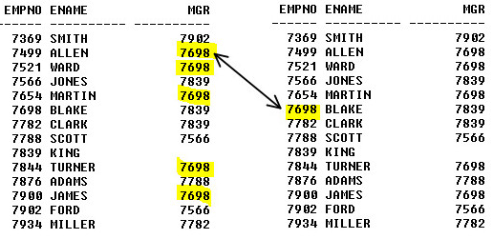
Joins
Self Join:
Query that joins table to itself
This table appears twice in the FROM clause and is followed by table aliases that qualify column names in the join condition.
Must create table alias
Alternate name assigned to table in query’s FROM clause
A
B

Slide 25
Joins:
Self-Join
Example
SELECT worker.first_name “FirstName”, worker.last_name “LastName”, manager.first_name||manager.last_name “ManagerName”
FROM employees worker, employees manager
WHERE worker.manager_id = manager.employee_id;

Slide 26
Suppose that we want to find all employees from employees table and their department_name from dept table. However the problem is some of the employees have a department_id that does not exist in dept table.
So which type of join can help us extract the data?
Answer: Outer Join.

Slide 27
Oracle SQL
SubQueries in SQL

Slide 28
SubQueries:
A subquery is a query within another query. The outer query is called as main query and inner query is called as subquery.
Subqueries enable you to write queries that select data rows for criteria that are actually developed while the query is executing at run time.
Using a subquery is equivalent to performing two sequential queries and using the result of the first query as the search value in the second query.
The subquery (inner query) executes before the main query (outer query).
The result of the subquery is used by the main query.
The subquery is often referred to as a nested SELECT, sub-SELECT, or inner SELECT statement.

Slide 29
SubQueries:
A subquery may occur in :
SELECT clause
FROM clause
WHERE clause
The subquery can be nested inside a SELECT, INSERT, UPDATE, or DELETE statement or inside another subquery.

Slide 30
SubQueries:
Types of Subqueries:
Single row subquery : Returns zero or one row.
Multiple row subquery : Returns one or more rows.
Multiple column subquery : Returns one or more columns.
Correlated subqueries : Reference one or more columns in the outer SQL statement. The subquery is known as a correlated subquery because the subquery is related to the outer SQL statement.
Inline Views: An inline view is a query placed inside the FROM clause or inside a WITH clause.

Slide 31
SubQueries:
Single row subquery :
A single row subquery returns all columns for a single row.
We can use a single row subquery as the select list of arguments for an INSERT, UPDATE, and DELETE statement.
It can be used with the equal comparison operators (=,<,>,<>, etc).
Example: Display the employees whose job ID is the same as that of employee 141
SELECT last_name, job_id FROM employees WHERE job_id = (SELECT job_id FROM employees WHERE employee_id = 141);

Slide 32
Subquery:
Single Row Subquery
Example: Display employees who do the same job as “Taylor,” but earn more salary than him.
Note: The outer and innner queries can get data from different tables
SELECT last_name, job_id FROM employees WHERE job_id =(SELECT job_id FROM employees WHERE employee_id = 141); AND salary > (SELECT salary
FROM employees
WHERE last_name=‘Taylor’);

Slide 33
Subquery:
Single Row Subquery
Example: Group By Functions in a Subquery
Display the employee last name, job ID, and salary of all employees whose salary is equal to the minimum salary.
Example : HAVING clause with subqueries
Display all the departments that have a minimum salary greater than that of department 50.
SELECT last_name "Last Name", first_name "First Name", salary "Salary"
FROM employees
WHERE salary = (SELECT MIN(salary)
FROM employees);
SELECT department_id,MIN(salary)
FROM employees
GROUP BY department_id
HAVING MIN(salary) >= (SELECT MIN(salary)
FROM employees
WHERE department_id=50);

Slide 34

SubQueries:
Single row subquery :
Two common errors that occurs when writing sub-queries are:
A single-row subquery returns more than one row.
If a subquery contains a GROUP BY clause. The GROUP BY clause implies that the subquery returns multiple rows, one value for each group the query encounters.
Another error occurs when you write a single-row subquery that returns no rows.

Slide 35

SubQueries:
Multiple row subquery :
Subqueries that return more than one row are called multiple-row subqueries.
You use a multiple-row operator, instead of a single-row operator, with a multiple-row subquery.
There are five multiple-row comparison operators you can use in a multiple-row subquery to compare a single value to a list of values. You can use IN, NOT IN, ANY, ALL, and BETWEEN.

Slide 36
SubQueries:
Multiple row subquery :
Example: Using IN Operator
e can use the IN operator to compare a single value specified in the outer query to any member in a list returned by a subquery.
A multiple-row subquery always must be enclosed in parentheses and must appear to the right of a multiple-row comparison operator.
SELECT last_name, salary, department_id FROM employees WHERE salary IN (SELECT MIN(salary) FROM employees GROUP BY department_id);

Slide 37
SubQueries:
Multiple row subquery :
Example: Using ANY Operator (Display employees who are not IT programmers and whose salary is less than that of any IT programmer.)
The ANY operator (and its synonym, the SOME operator) compares a value to ach value returned by a subquery.
Here:
ANY means less than the maximum.
>ANY means more than the minimum.
=ANY is equivalent to IN.
SELECT employee_id,last_name, job_id,salary FROM employees WHERE salary < ALL (SELECT mgr.manager_id FROM employees mgr);

Slide 38
SubQueries:
Multiple row subquery :
Example: Using ALL Operator (Display employees whose salary is less than the salary of all employees with a job ID of IT_PROG and whose job is not IT_PROG.)
The ALL operator compares a value to every value returned by a sub query.
Here :
ALL means more than the maximum and
<ALL means less than the minimum.
SELECT emp.last_name FROM employees emp WHERE emp.employee_id < ALL (SELECT salary FROM employees WHERE job_id=‘IT_PROG’);

Slide 39
SubQueries:
Example: Using NOT Operator
The NOT operator can be used with IN, ANY, and ALL operators.
Display all employees who do not have any subordinates:Multiple row subquery :
Note: If one of the values returned by the inner query is a null value, the entire query returns no rows.
The reason is that all conditions that compare a null value result in a null.
So whenever null values are likely to be part of the results set of a subquery, do not use the NOT IN operator. The NOT IN operator is equivalent to <> ALL.
SELECT last_name FROM employees WHERE employee_id NOT IN (SELECT manager_id FROM employees WHERE manager_id IS NOT NULL);

Slide 40
SubQueries:
Multiple column subquery :
There are times when you need to use a subquery that compares more than just one column between the parent query and the subquery. This is known as a multiple-column subquery.
the IN clause is used to compare the outer query's columns to the columns of the subquery.
A subquery in which more than one column is selected for comparison to the main query using the same number of columns.
Example:
If the columns do not match in number, then an error message is displayed.
If the data types do not match, then the results of the query are incorrect.
SELECT employee_id, last_name, job_id, salary
FROM employees
WHERE (job_id, salary) IN (select job_id, salary
FROM employees
WHERE employee_id = 136);

Slide 41
SubQueries:
Multiple Column subquery :
Example: Display only those employees who have worked the longest time in each job title.
SELECT first_name, job_id, hiredate
From employees WHERE (job_id,hiredate) IN
(SELECT job_id,MIN(hiredate_date) FROM employees GROUP BY job_id);

Slide 42
SubQueries:
Multiple Column subquery :
Example: Display details about employees whose salary and commission match the salary and commission of any employee in Department 30.
SELECT first_name, department_id, salary, commission_pct
FROM employees
WHERE (salary, NVL(commission_pct,-1)) IN
(SELECT salary, NVL(commission_pct,-1)
FROM employees WHERE department_id = 30);

Slide 43
SubQueries:
Multiple Column subquery :
Queries in FROM Clause
We can create a logical subset of data by writing a subquery in the FROM clause of a SELECT statement.
These subsets are virtual tables that we can use to return specific data to the main query.
Use a table alias to identify the result set of the subquery
Example: Display the names, salaries, department numbers, and average salaries for all employees who earn more than the average salaries in their departments.
SELECT a.first_name, a.salary, a.department_id, b.salavg FROM employees a,
(SELECT department_id, AVG(salary) salavg
FROM employees GROUP BY department_id ) b WHERE a. department_id =b. department_id AND a.salary > b.salavg

Slide 44
SubQueries:
Multiple Column subquery :
Queries in FROM Clause
Example: Display details for employees who earn the lowest salary in each job title.
SELECT e.job_id, e.first_name, e.salary, sub.low_sal
FROM employees e,
(SELECT job_id, MIN(salary) low_sal
FROM employees
GROUP BY job_id) sub
WHERE e.job_id = sub.job_id
AND e.salary = sub.low_sal;

Slide 45
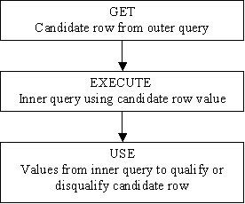
SubQueries:
Correlated Subqueries:
A subquery that contains a reference to a column in the main, or parent, query and is evaluated once for each row of the outer query.
A correlated subquery looks very much like other subquery, with one important difference:
The correlated subquery references a column in the main query as part of the qualification process to see if a given row will be returned by the query.
For each row in the parent query, the subquery is evaluated to see if the row will be returned.
It is used for row-by-row processing.
Each subquery is executed once for every row of the outer query.

Slide 46
SubQueries:
Correlated Sub Query :
Example: Display employees who earn more than the average for their department across all departments.
SELECT employee_id, last_name, department_id, salary
FROM employees emp
WHERE salary > (SELECT avg(salary)
FROM employees
WHERE department_id = emp.department_id);

Slide 47
SubQueries:
Correlated Sub Query :
Example: Display details of those employees who have switched jobs at least twice.
SELECT e.employee_id, e.last_name, e.job_id FROM employees e WHERE 2 <= ( SELECT COUNT(*) FROM job_history WHERE employee_id = e.employee_id);

Slide 48
SubQueries:
In-line views:
The inline view is a construct in Oracle SQL where you can place a query in the SQL FROM, clause, just as if the query was a table name.
It allows you to use a filtered data set not found in a table like a view, but only in the scope of the query or SQL statement.
A common use for in-line views in Oracle SQL is
to simplify complex queries by removing join operations and
condensing several separate queries into a single query.

Slide 49
SubQueries:
Example: Display the employees who earn the highest salary in each department.
SELECT a.last_name, a.salary, a.department_id, b.maxsal FROM employees a,
( SELECT department_id, max(salary) maxsal
FROM employees
GROUP BY department_id ) b
WHERE a.department_id = b.department_id
AND a.salary = b.maxsal;

Slide 50
SubQueries:
Some Guidelines while using sub queries are:
A subquery must be enclosed in parentheses.
A subquery must be placed on the right side of the comparison operator.
Sub queries cannot manipulate their results internally, therefore ORDER BY clause cannot be added in to a subquery.
However we can use a ORDER BY clause in the main SELECT statement (outer query) which will be last clause.
Use single-row operators with single-row sub queries.
If a subquery (inner query) returns a null value to the outer query, the outer query will not return any rows when using certain comparison operators in a WHERE clause.

Slide 51
Recap
Set Operations:
Used to combine the results of more than one Query
Different types of set Operations supported are:
UNION, UNION ALL, INTERSECT and MINUS
Joins:
Used to fetch the results from more than one table
Different Joins supported are :
INNER JOIN,OUTER JOIN and SELF Join
SubQueries:
Used to write a Query within another Query

